Slide 1

IRONWORKS Retail Strategy
Capstone Presentation
Eliot Cleveland – MBA Candidate
February 17, 2020

Slide 2
Low sales culture misses opportunity to increase retail sales
Ironworks service revenue continues to grow, retail sales stagnate
Current situation
Retail sales peaked at 10% of service revenue in August ’18, declined gradually to about 5% of service revenue as of September 2019
Service revenue has grown steadily over the same time period, about 3% per month
2019 Retail Sales Estimate~$24k
Desired situation
Retail sales should ideally grow in tandem with service revenue growth by virtue of increased foot traffic
Additional retail revenue should be self-sustaining, increase bottom line and shorten debt horizon
2020 Retail Sales Forecast~$41k

Slide 3
Decision Criteria
Ironworks should implement a Change Management Program focused on increasing retail sales in a way that improves customer experience and strengthens its position as a supply company
Priority | What is important | Why this is important
1 | Retail revenue growth | Retail sales growth will increase profitability even when service capacity is met. Building Ironworks’ reputation as a retailer is a virtuous cycle.
2 | Support core business, service revenue | Service revenue is the core profit driver. Any increases in retail sales should not inhibit customer retention.
3 | Consistency of customer experience | Changes to sales approach should be delicate yet deliberate.
4 | Staff Retention | Longevity is a strength of Ironworks. The staff should have an active role in decisionmaking
5 | Build Ironwork’s brand | The brand becomes increasingly important as the company continues to grow

Slide 4
Alternative Solutions
Simple solutions risk a “pushy” sales environment, carry an increased financial burden, or may be ineffective because they do not address the need for a change in culture
Direct commission to service or front desk staff
Incentivize sales increases purely by instituting a sales commission on retail products.
Stylists or front desk staff bear the weight of driving sales increases.
Increase variety of offerings
Drive sales increases by adding more offerings; cast a wide net.
Use technology to encourage retail sales growth
Push sales using Booker app, email or social media

Slide 5
Decision Matrix
None of these options offers a comprehensive solution to sustainably drive retail sales growth
 | Retail Revenue Growth | Support Service Revenue | Customer Experience | Staff Retention | Build Ironworks’ Brand | Summary: priority ranking
Commission | Yes | No | No | No | No | 3
Increase Variety | No | Maybe | Yes | Yes | Maybe | 1
Technology | Yes | No | No | Yes | No | 2

Slide 6
Details of Change Management Plan
The Change Management Plan is a process that will require input and buy-in from the entire Ironworks’ staff
When | 14 days | 30 days | 60 days | 90 days
What | Phase 1: Create a sense of urgency | Phase 2: Build a guiding coalition | Phase 3: Form a strategic vision and initiatives | Phase 4: Enlist a volunteer army
Who | Owner | Owner + First Followers | All Staff | Owner + First Followers
Activities | Explain to staff the magnitude of the drop in sales. Let them know they will be part of the decision-making process | Discuss staff concerns/ideas now that the topic has been broached | Discuss why and if making significant retail growth is important. Future Planning | Form an implementation plan. Trial phase – see what works and adjust
Outputs | Awareness across company | Establish business priorities | Vision Statement | Preliminary findings, adjustments

Slide 7
Details of Change Management Plan
The Change Management Plan will gradually build and sustain buy in by constant assessment and revision until consistent participation is realized
When | 120 days | 150 days | 180 days | 270 days
What | Phase 5: Enable action by removing barriers | Phase 6: Generate short-term wins | Phase 7: Sustain Acceleration | Phase 8: Institute Change
Who | All Staff | Owner | All Staff | All Staff
Activities | Identify weak points of plan. What might ensure positive response from all parties involved? | Track sales, acknowledge early successes, celebrate top performers/most-improved. | Continue to assess and improve processes | Notable retail sales gains and staff exuberance about the new normal
Outputs | More training, adjustments to sale procedures | Validation of efforts | Updates to vision and initiatives | Sustained cultural change at Ironworks

Slide 8
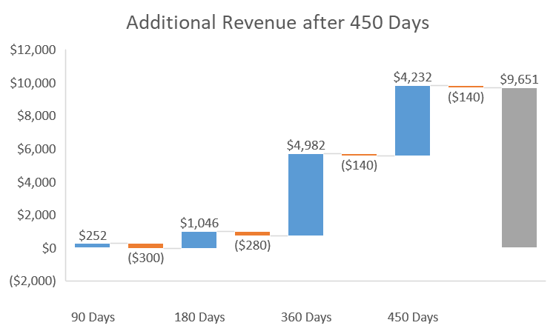
Financial Justification
Insert topic sentence here that summarizes the cost and financial benefit of your recommended initiative.
 | 90 Days | 180 Days | 360 Days | 450 Days
Profit uplift (a) | $ 252 | $ 1046 | $ 4982 | $ 4232
Additional payroll (b) incurred | $ 300 | $ 280 | $ 140 | $ 140
Net benefit | $ (-48) | $ 720 | $ 5561 | $ 9652
Retail % of Service Sales (d) | 5.97 % | 6.96 % | 8.94 % | 9.93 %
Assumptions used:
Using product revenue-COGS July ‘19-Sept ‘19 as 90 day revenue base
(b) Additional payroll for staff. 1 hour per staff per scheduled meeting @ $20/hr
“First Followers” = 4 staff, All Staff = 7 staff
(c) Assumes .33% growth in retail sales percentage of service revenue
and 3% service revenue growth each month until benchmark is met (10%)
Notes:
An alternative for certain types of initiatives:

Slide 9
Risks and Contingencies
Change Management Program must closely monitor risks to brand, core service business, human & financial resources
Risk | Contingency
1. Sales tactics become pushy | Track buying attitudes of customers and cease selling tactics per customer preference.
2. Stylists sales tactics ineffective | Assess on a case by case basis. Offer counsel and additional training if needed to ensure consistency across staff.
3. Employee morale slips | Celebrate small victories and milestones within the program.
4. Inventory gets heavy | Purchase inventory, especially new items in small quantities whenever possible

Slide 10
Summary Take Away
A comprehensive and sustained effort which aligns with Ironworks’ brand, staff and future aspirations is needed to secure and sustain future growth
Situation
Retail sales are gradually slipping away despite increasing customer base.
Action
Implement a Change Management Program designed to sustain and grow retail sales.
Result
Ironworks will strengthen its revenue structure.
$10k additional revenue after 15 months to invest in future growth.

Slide 11
IRONWORKS Retail Strategy
Capstone Presentation
Eliot Cleveland – MBA Candidate
February 17, 2020

